Slide 1
Data Encryption Standard
This lecture slide is mainly based on the power point slides by Professor Lawrie Brown.
Notes:
Zili Shao

Slide 2
Secret Key System
The keys for the encryption and the decryption algorithm
are the same.
Some well-known secret key systems: DES、RC2、RC4、
IDEA、SAFER、FEAL、Skipjack、Blowfish, AES.
Feistel Structure: DES, Blowfish, FEAL, Twofish
CEG 260, Meilin Liu
Notes:
Zili Shao

Slide 3
Block vs Stream Ciphers
Block ciphers process messages in blocks, each of which is then en/decrypted
Like a substitution on very big characters
  64-bits or more
Stream ciphers process messages a bit or byte at a time when en/decrypting
Many modern ciphers are block ciphers
CEG 260, Meilin Liu
Notes:
Zili Shao
Block ciphers work a on block / word at a time, which is some number of bits. All of these bits have to be available before the block can be processed. Stream ciphers work on a bit or byte of the message at a time, hence process it as a “stream”.

Slide 4
Diffusion and Confusion
The terms were introduced by Claude Shannon.
They are two basic building blocks for any cryptographic system.
CEG 260, Meilin Liu
Notes:
Zili Shao

Slide 5
Diffusion and Confusion
Diffusion: One bit change in the plaintext affect many bits of ciphertext digits, which is equivalent to saying that each ciphertext bit is affected by many plaintext bits.
CEG 260, Meilin Liu
Notes:
Zili Shao

Slide 6
Diffusion and Confusion
Confusion seeks to make the relationship between the statistics of the ciphertext and the value of the encryption key as complex as possible, so make it hard to deduce the key.
CEG 260, Meilin Liu
Notes:
Zili Shao

Slide 7
Basic Methods of Symmetric Encryption
1. Substitution:
Noclasstoday→ opdmbttupebz
2. Transposition: rearrange the sequence of the plaintext
Noclasstoday→ ncossaolstdy
3. Product: Multiple stages of Substitution and Transposition
CEG 260, Meilin Liu
Notes:
Zili Shao

Slide 8
Block ciphers: crypto work horse
n bits
n bits
E, D
PT Block
CT Block
Key
k bits
Canonical examples:
DES: n= 64 bits, k = 56 bits
AES: n=128 bits, k = 128, 192, 256 bits

Slide 9
Block Ciphers Built by Iteration
key k
key expansion
k₁
k₂
k₃
k_{n}
m
R(k₁, ⋅)
R(k₂, ⋅)
R(k₃, ⋅)
R(k_{n}, ⋅)
c
R(k,m) is called a round function
for DES (n=16), for AES-128 (n=10)

Slide 10
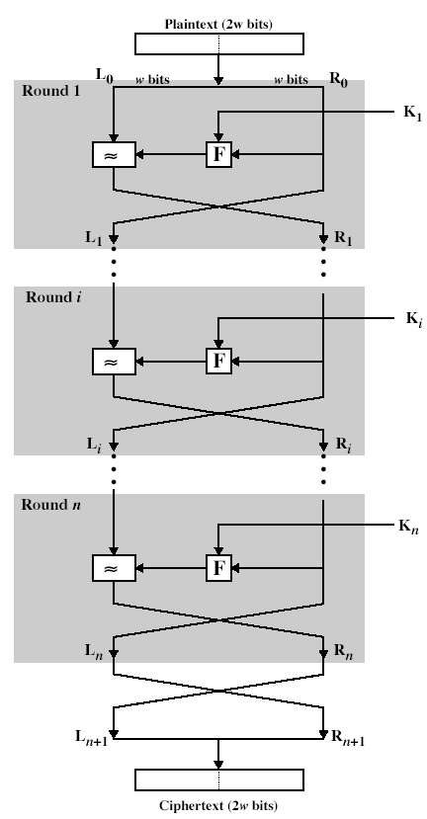
Feistel Cipher Structure
CEG 260, Meilin Liu
Notes:
Zili Shao

Slide 11
Feistel Cipher Structure
Input: 2*w bits (L0, R1)
L1=R0, R1=L0 XOR F(R0, K1) K1 is the first subkey.
One key to generate n subkey by
Some find of shifting
2w
L₀
R₀
K₁
XOR
F
Round 1
L₁
R₁
CEG 260, Meilin Liu
Notes:
Zili Shao

Slide 12
Feistel Cipher Structure
Li=Ri-1; Ri=Li-1 XOR F(Ri-1, Ki)
L_{i-1}
R_{i-1}
K_{i}
XOR
F
Round i
L_{i}
R_{i}
CEG 260, Meilin Liu
Notes:
Zili Shao

Slide 13
Feistel Cipher Structure
Is that necessary that function F need to invertible?
How to decrypt the cipher text?
CEG 260, Meilin Liu
Notes:
Zili Shao

Slide 14
Feistel Cipher Design Features
Block size
  Larger block sizes mean greater security but reduced encryption/decryption speed for a given algorithm
Key size
  Larger key size means greater security but may decrease encryption/decryption speeds
Number of rounds
  The essence of the Feistel cipher is that a single round offers inadequate security but that multiple rounds offer increasing security
Subkey generation algorithm
  Greater complexity in this algorithm should lead to greater difficulty of cryptanalysis
Round function F
  Greater complexity generally means greater resistance to cryptanalysis
Fast software encryption/decryption
  In many cases, encrypting is embedded in applications or utility functions in such a way as to preclude a hardware implementation; accordingly, the speed of execution of the algorithm becomes a concern
Ease of analysis
  If the algorithm can be concisely and clearly explained, it is easier to analyze that algorithm for cryptanalytic vulnerabilities and therefore develop a higher level of assurance as to its strength
© 2020 Pearson Education, Inc., Hoboken, NJ. All rights reserved.
Notes:
The exact realization of a Feistel network depends on the choice of the following
parameters and design features:
• Block size: Larger block sizes mean greater security (all other things being
equal) but reduced encryption/decryption speed for a given algorithm. The
greater security is achieved by greater diffusion. Traditionally, a block size of
64 bits has been considered a reasonable tradeoff and was nearly universal in
block cipher design. However, the new AES uses a 128-bit block size.
• Key size: Larger key size means greater security but may decrease encryption/
decryption speed. The greater security is achieved by greater resistance to
brute-force attacks and greater confusion. Key sizes of 64 bits or less are now
widely considered to be inadequate, and 128 bits has become a common size.
• Number of rounds: The essence of the Feistel cipher is that a single round
offers inadequate security but that multiple rounds offer increasing security.
A typical size is 16 rounds.
• Subkey generation algorithm: Greater complexity in this algorithm should
lead to greater difficulty of cryptanalysis.
• Round function F: Again, greater complexity generally means greater resistance
to cryptanalysis.
There are two other considerations in the design of a Feistel cipher:
• Fast software encryption/decryption: In many cases, encryption is embedded in
applications or utility functions in such a way as to preclude a hardware implementation.
Accordingly, the speed of execution of the algorithm becomes a
concern.
• Ease of analysis: Although we would like to make our algorithm as difficult as
possible to cryptanalyze, there is great benefit in making the algorithm easy to
analyze. That is, if the algorithm can be concisely and clearly explained, it is
easier to analyze that algorithm for cryptanalytic vulnerabilities and therefore
develop a higher level of assurance as to its strength. DES, for example, does
not have an easily analyzed functionality.

Slide 15
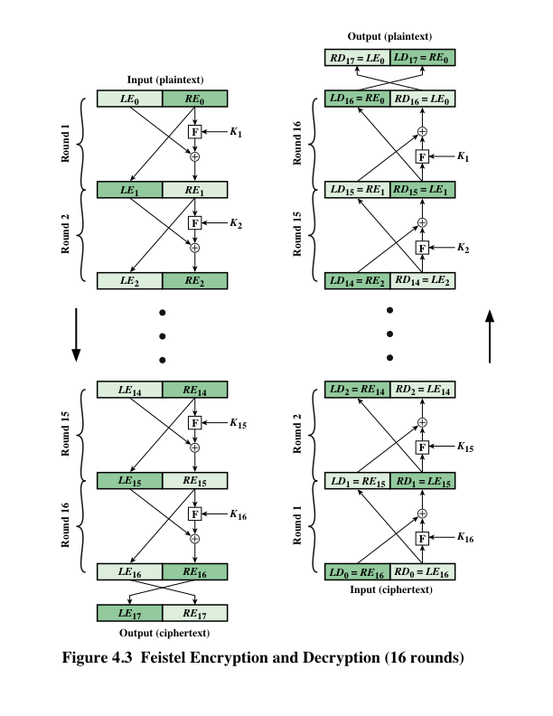
Feistel Cipher
Encryption and
Decryption
Notes:
The left-hand side of Figure 4.3 depicts the structure
proposed by Feistel. The inputs to the encryption algorithm are a plaintext block of
length 2w bits and a key K . The plaintext block is divided into two halves, LE₀ and RE₀ .
The two halves of the data pass through n rounds of processing and then combine to
produce the ciphertext block. Each round i has as inputs LE_{i-1} and RE_{i-1} derived from
the previous round, as well as a subkey K_{i} derived from the overall K . In general,
the subkeys K_{i} are different from K and from each other. In Figure 4.3, 16 rounds
are used, although any number of rounds could be implemented.
All rounds have the same structure. A substitution is performed on the left half
of the data. This is done by applying a round function F to the right half of the data
and then taking the exclusive-OR of the output of that function and the left half of the
data. The round function has the same general structure for each round but is parameterized
by the round subkey K_{i} . Another way to express this is to say that F is a function
of right-half block of w bits and a subkey of y bits, which produces an output value
of length w bits: F (RE_{i} , K_{i+1} ). Following this substitution, a permutation is performed
that consists of the interchange of the two halves of the data. This structure is a particular
form of the substitution-permutation network (SPN) proposed by Shannon.

Slide 16
DES (Data Encryption Standard)
The most widely used encryption scheme is based on the Data Encryption Standard (DES) adopted in 1977 by the National Bureau of Standards, now the National Institute of Standards and Technology (NIST), as Federal Information Processing Standard 46 (FIPS PUB 46).
CEG 260, Meilin Liu
Notes:
Zili Shao

Slide 17
Data Encryption Standard (DES)
Most widely used block cipher in world
Adopted in 1977 by NBS (now NIST)
  as FIPS PUB 46
Encrypts 64-bit data using 56-bit key
Has widespread use
Has been considerable controversy over its security
Easy in hardware, slow in software
CEG 260, Meilin Liu
Notes:
Zili Shao

Slide 18
DES History
IBM developed Lucifer cipher
  by team led by Feistel
  used 64-bit data blocks with 128-bit key
Then redeveloped as a commercial cipher with input from NSA and others
In 1973, NBS issued request for proposals for a national cipher standard
IBM submitted their revised Lucifer which was eventually accepted as the DES
CEG 260, Meilin Liu
Notes:
Zili Shao

Slide 19
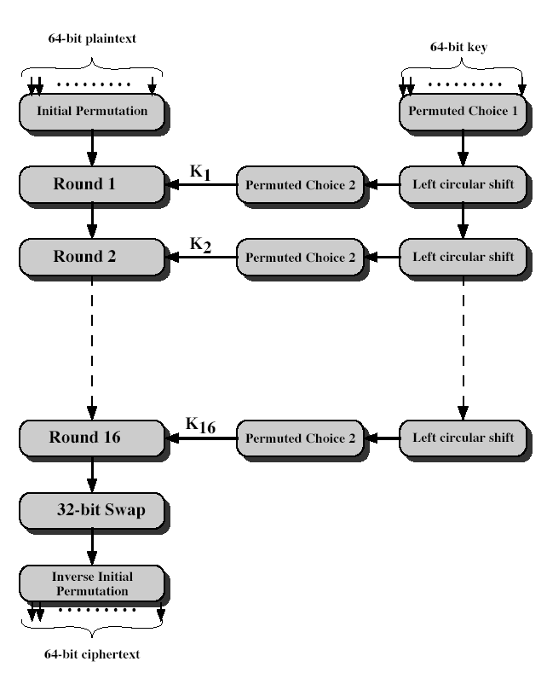
DES Encryption
CEG 260, Meilin Liu
Notes:
Zili Shao
The basic process in enciphering a 64-bit data block using the DES, shown on the left side, consists of:
- an initial permutation (IP)
- 16 rounds of a complex key dependent round function involving substitution and permutation functions
- a final permutation, being the inverse of IP
The right side shows the handling of the 56-bit key and consists of:
- an initial permutation of the key (PC1) which selects 56-bits in two 28-bit halves
- 16 stages to generate the subkeys using a left circular shift and a permutation

Slide 20
DES Initial Permutations
1 2 3 4 5 6 7 8
9 10 11 12 13 14 15 16
17 18 19 20 21 22 23 24
25 26 27 28 29 30 31 32
33 34 35 36 37 38 39 40
41 42 43 44 45 46 47 48
49 50 51 52 53 54 55 56
57 58 59 60 61 62 63 64
CEG 260, Meilin Liu
Notes:
Zili Shao

Slide 21
DES Initial Permutations
58 50 42 34 26 18 10 2
60 52 44 36 28 20 12 4
62 54 46 38 30 22 14 6
64 56 48 40 32 24 16 8
57 49 41 33 25 17 9 1
59 51 43 35 27 19 11 3
61 53 45 37 29 21 13 5
63 55 47 39 31 23 15 7
CEG 260, Meilin Liu
Notes:
Zili Shao

Slide 22
Initial Permutation
Bit goes to Bit
58 1
50 2
42 3
34 4
26 5
18 6
10 7
2 8
60 9
52 10
44 11
36 12
28 13
20 14
12 15
4 16
Bit goes to Bit
62 17
54 18
46 19
38 20
30 21
22 22
14 23
6 24
64 25
56 26
48 27
40 28
32 29
24 30
16 31
8 32
Bit goes to Bit
57 33
49 34
41 35
33 36
35 37
17 38
9 39
1 40
59 41
51 42
43 43
35 44
27 45
19 46
11 47
3 48
Bit goes to Bit
61 49
53 50
45 51
37 52
29 53
21 54
13 55
5 56
63 57
55 58
47 59
39 60
31 61
23 62
15 63
7 64
CEG 260, Meilin Liu
Notes:
Zili Shao

Slide 23
Initial Permutation Pictorially
Bit goes to Bit
58 1
50 2
42 3
34 4
26 5
18 6
10 7
2 8
60 9
52 10
44 11
36 12
28 13
20 14
12 15
4 16
CEG 260, Meilin Liu
Notes:
Zili Shao

Slide 24
Initial Permutation IP
IP reorders the input data bits even bits to LH half, odd bits to RH half quite regular in structure (easy in hardware)
Example:
IP(675a6967 5e5a6b5a) = (ffb2194d 004df6fb)
CEG 260, Meilin Liu
Notes:
Zili Shao
The initial permutation and its inverse are defined by tables, as shown in Tables 3.2a and 3.2b, respectively. The tables are to be interpreted as follows. The input to a table consists of 64 bits numbered from 1 to 64. The 64 entries in the permutation table contain a permutation of the numbers from 1 to 64. Each entry in the permutation table indicates the position of a numbered input bit in the output, which also consists of 64 bits.
Note that the bit numbering for DES reflects IBM mainframe practice, and is the opposite of what we now mostly use - so be careful! Numbers from Bit 1 (leftmost, most significant) to bit 32/48/64 etc (rightmost, least significant).
Note that examples are specified using hexadecimal.

Slide 25
Initial Permutation IP
IP reorders the input data bits even bits to LH half, odd bits to RH half quite regular in structure (easy in hardware)
Example:
IP(675a6967 5e5a6b5a) = (ffb2194d 004df6fb)
0110 0111 (bit 1-8) 1111 1111
0101 1010 (bit 9-16) 1011 0010
0110 1001 (bit 17-24) 0001 1001
0110 0111 (bit 25-32) 0100 1101
0101 1110 (bit 33 – 40) ----→ 0000 0000
0101 1010 (bit 41 – 48) 0100 1101
0110 1011 (bit 49-56) 1111 0110
0101 1010 (bit 57 - 64) 1111 1011
CEG 260, Meilin Liu
Notes:
Zili Shao
The initial permutation and its inverse are defined by tables, as shown in Tables 3.2a and 3.2b, respectively. The tables are to be interpreted as follows. The input to a table consists of 64 bits numbered from 1 to 64. The 64 entries in the permutation table contain a permutation of the numbers from 1 to 64. Each entry in the permutation table indicates the position of a numbered input bit in the output, which also consists of 64 bits.
Note that the bit numbering for DES reflects IBM mainframe practice, and is the opposite of what we now mostly use - so be careful! Numbers from Bit 1 (leftmost, most significant) to bit 32/48/64 etc (rightmost, least significant).
Note that examples are specified using hexadecimal.

Slide 26
DES Final Permutations
40 8 48 16 56 24 64 32
39 7 47 15 55 23 63 31
38 6 46 14 54 22 62 30
37 5 45 13 53 21 61 29
36 4 44 12 52 20 60 28
35 3 43 11 51 19 59 27
34 2 42 10 50 18 58 26
33 1 41 9 49 17 57 25
CEG 260, Meilin Liu
Notes:
Zili Shao

Slide 27
DES Round Structure
Uses two 32-bit L & R halves
As for any Feistel cipher can describe as:
  L_{i} = R_{i–1}
  R_{i} = L_{i–1} xor F(R_{i–1}, K_{i})
Takes 32-bit R half and 48-bit subkey and:
  expand from 32 to 48 bits: 4-bit chunks, borrow bits from neighbors
  adds to subkey
  passes through 8 S-boxes to get 32-bit result
  finally permutes this using 32-bit perm P
CEG 260, Meilin Liu
Notes:
Zili Shao
Note that the s-boxes provide the “confusion” of data and key values, whilst the permutation P then spreads this as widely as possible, so each S-box output affects as many S-box inputs in the next round as possible, giving “diffusion”.

Slide 28
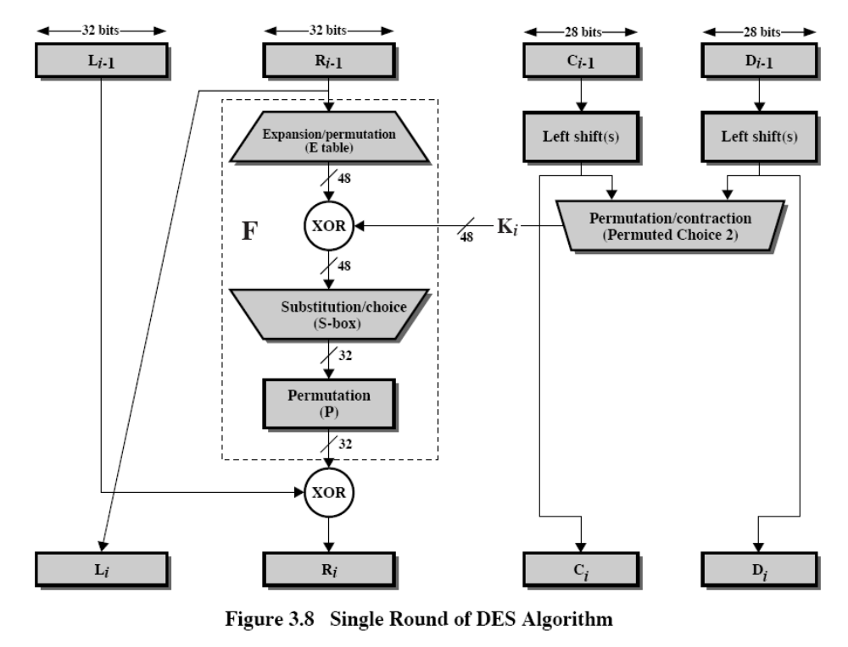
DES Single Round
CEG 260, Meilin Liu
Notes:
Zili Shao
Note that the s-boxes provide the “confusion” of data and key values, whilst the permutation P then spreads this as widely as possible, so each S-box output affects as many S-box inputs in the next round as possible, giving “diffusion”.

Slide 29
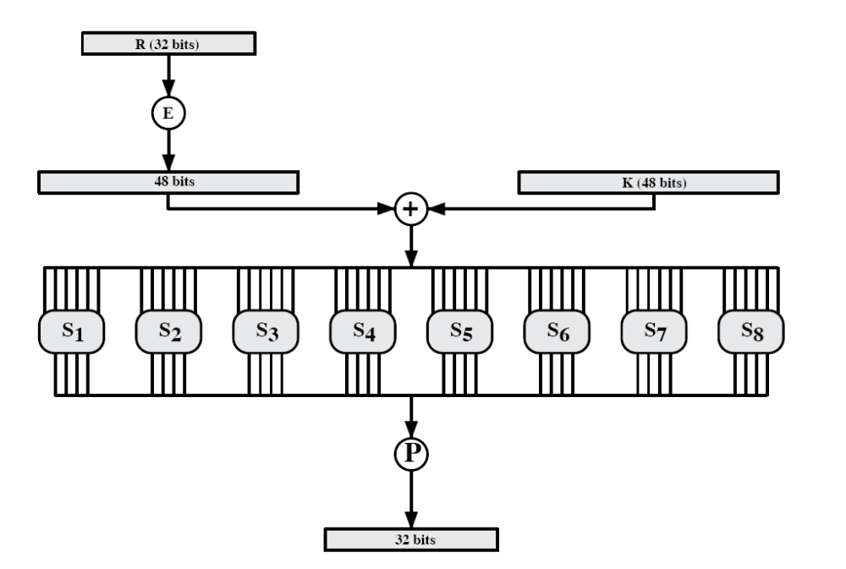
F-function
CEG 260, Meilin Liu
Notes:
Zili Shao

Slide 30
Expansion Permutation Table
32 1 2 3 4 5
4 5 6 7 8 9
8 9 10 11 12 13
12 13 14 15 16 17
16 17 18 19 20 21
20 21 22 23 24 25
24 25 26 27 28 29
28 29 30 31 32 1
CEG 260, Meilin Liu
Notes:
Zili Shao

Slide 31
S-Box
It’s the component in DES for confusion.
There are 8 S-Boxes in DES.
For each S-Box, it is a function with 6-bit input and 4-bit output.
CEG 260, Meilin Liu
Notes:
Zili Shao

Slide 32
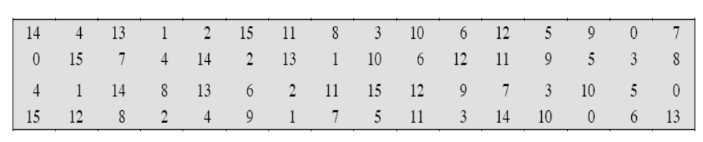
S-Box
Example :
Input : b5b4b3b2b1b0=010010.
Taking b5b0= 00= 0as the number of row.
Taking b4b3b2b1=1001= 9 as the number of column.
By looking up the table (S-Box), the output is 10.
Output : 1010.
CEG 260, Meilin Liu
Notes:
Zili Shao

Slide 33
The 8 DES S Boxes
48-bit Input
0 … 5
6 … 11
12 … 17
18 … 23
24 … 29
30 … 35
35 … 41
42 … 47
S-Box 1
S-Box 2
S-Box 3
S-Box 4
S-Box 5
S-Box 6
S-Box 7
S-Box 8
0 … 3
4 … 7
8 … 11
12 … 15
16 … 19
20 … 23
24 … 27
28 … 31
32-bit Output
CEG 260, Meilin Liu
Notes:
Zili Shao

Slide 34
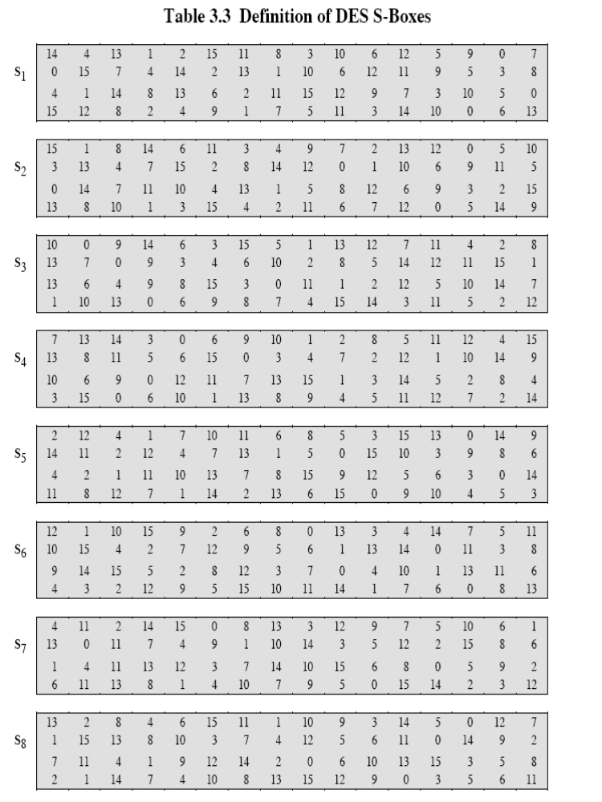
The 8 DES S Boxes
CEG 260, Meilin Liu
Notes:
Zili Shao

Slide 35
Permutation Functions
It’s the component in DES for diffusion.
In DES, there are some different permutation functions:
  Initial permutation (bitwise)
    Expansion permutation
    P-Box permutation
    Final permutation
    Permutation Choice 1 (for key generation)
    Permutation Choice 2 (for key generation)
CEG 260, Meilin Liu
Notes:
Zili Shao

Slide 36
Permutation Function - P Box
16 7 20 21 29 12 28 17
1 15 23 26 5 18 31 10
2 8 24 14 32 27 3 9
19 13 30 6 22 11 4 25
CEG 260, Meilin Liu
Notes:
Zili Shao

Slide 37
DES Key Generater
Generating subkeys used in each round
Consisting of:
  Initial permutation of the key (PC1) which selects 56-bits in two 28-bit halves
  16 stages consisting of:
    selecting 24-bits from each half
    permuting them by PC2 for use in function F,
    rotating each half separately either 1 or 2 places depending on the key rotation schedule K
CEG 260, Meilin Liu
Notes:
Zili Shao
The 56 bit key size comes from security considerations as we know now. It was big enough so that an exhaustive key search was about as hard as the best direct attack (a form of differential cryptanalysis called a T-attack, known by the IBM & NSA researchers), but no bigger. The extra 8 bits were then used as parity (error detecting) bits, which makes sense given the original design use for hardware communications links. However we hit an incompatibility with simple s/w implementations since the top bit in each byte is 0 (since ASCII only uses 7 bits), but the DES key schedule throws away the bottom bit! A good implementation needs to be cleverer!
Details of these permutations and the key rotation schedule are given in text Table 3.4.

Slide 38
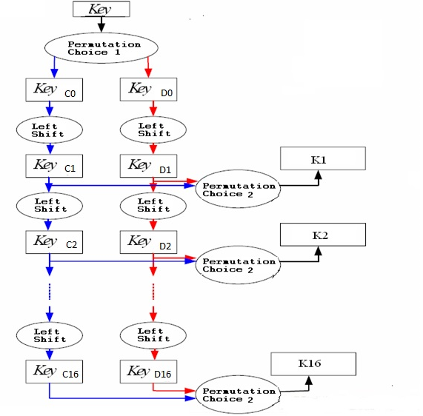
Key Generator
CEG 260, Meilin Liu
Notes:
Zili Shao

Slide 39
Input Key
1 2 3 4 5 6 7 8
9 10 11 12 13 14 15 16
17 18 19 20 21 22 23 24
25 26 27 28 29 30 31 32
33 34 35 36 37 38 39 40
41 42 43 44 45 46 47 48
49 50 51 52 53 54 55 56
57 58 59 60 61 62 63 64
CEG 260, Meilin Liu
Notes:
Zili Shao

Slide 40
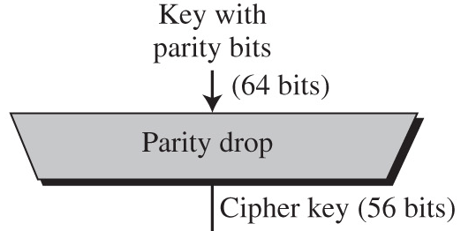
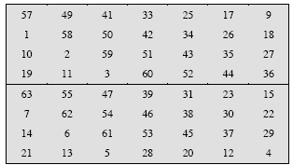
Parity Bit Drop, Permutation Choice 1
Every 8th bit of key input used for parity check to detect transmission errors
This stage removes the parity bits and shuffles key bits
Permutation Choice 1
CEG 260, Meilin Liu
Notes:
Zili Shao

Slide 41
Key Generator
Round Number | 1 | 2 | 3 | 4 | 5 | 6 | 7 | 8 | 9 | 10 | 11 | 12 | 13 | 14 | 15 | 16
Number of Left Shifts | 1 | 1 | 2 | 2 | 2 | 2 | 2 | 2 | 1 | 2 | 2 | 2 | 2 | 2 | 2 | 1
Total Number of Shifts | 1 | 2 | 4 | 6 | 8 | 10 | 12 | 14 | 15 | 17 | 19 | 21 | 23 | 25 | 27 | 28
rounds 1, 2, 9, 16: single-bit rotate left
otherwise: two-bit rotate left
CEG 260, Meilin Liu
Notes:
Zili Shao

Slide 42
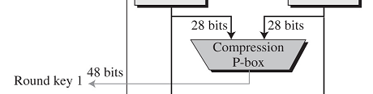
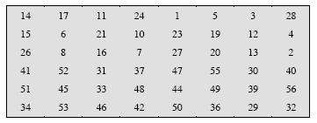
Round Key Compression (Permutation Choice 2)
Reduces round key to 48 bits to match bits in mixer
Combined with shifts, assures different bits used in each round key (different bits removed each round)
Bits 9,18,22,25,35,38,43,54 are dropped.
CEG 260, Meilin Liu
Notes:
Zili Shao

Slide 43
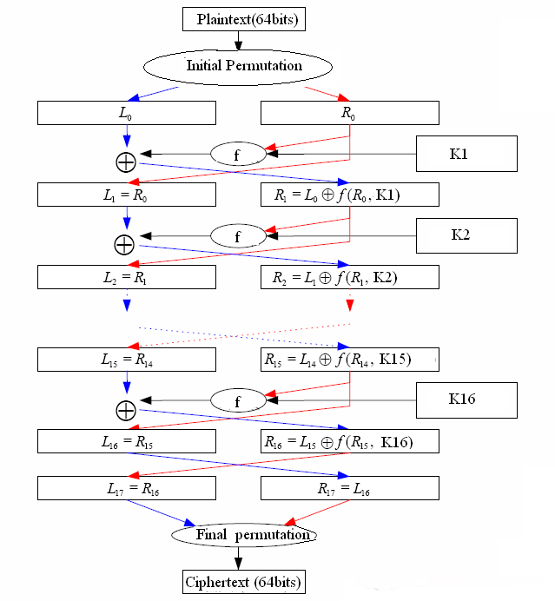
DES Encryption Algorithm
CEG 260, Meilin Liu
Notes:
Zili Shao

Slide 44
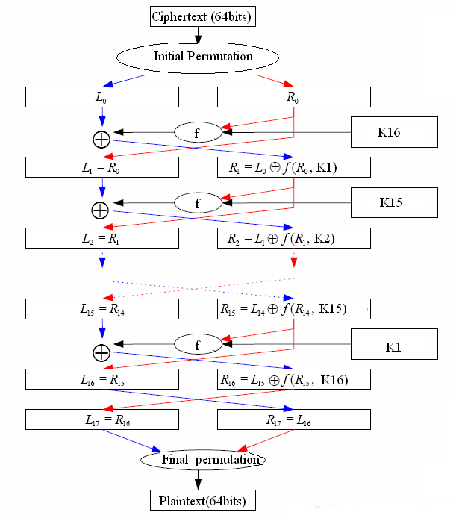
DES Decryption Algorithm
CEG 260, Meilin Liu
Notes:
Zili Shao

Slide 45
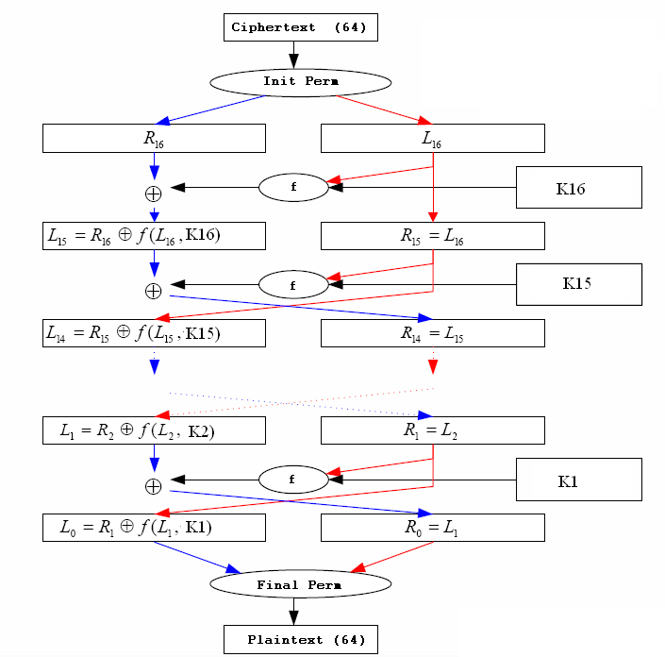
DES Decryption Algorithm
CEG 260, Meilin Liu
Notes:
Zili Shao

Slide 46
DES Decryption
With Feistel design, do encryption steps again
  Using subkeys in reverse order (SK16 … SK1)
  note that IP undoes final FP step of encryption
  1st round with SK16 undoes 16th encrypt round
  ….
  16th round with SK1 undoes 1st encrypt round
  Final FP undoes initial encryption IP
CEG 260, Meilin Liu
Notes:
Zili Shao

Slide 47
Reverse Function
The function f need not be reversible
Encryption
  L2= R1
  R2= L1 XOR f(R1, K2)
Decryption
  R1= L2
  L1= R2 XOR f(R1, K2)
  implies
  L1= R2 XOR f(L2, K2)
CEG 260, Meilin Liu
Notes:
Zili Shao

Slide 48
Reverse Function – Cont.
Encryption
  Lj= Rj-1
  Rj= Lj-1 XOR f(Rj-1, Kj)
By rewriting these equations in terms of Lj-1 and Rj-1, we get the decryption process
  Rj-1= Lj
  Lj-1= Rj XOR f(Rj-1, Kj)
  Lj-1= Rj XOR f(Lj, Kj)
DES is a reversible procedure; but the function f need not be reversible
CEG 260, Meilin Liu
Notes:
Zili Shao

Slide 49
DES – Feistel Structure
CEG 260, Meilin Liu
Notes:
Zili Shao

Slide 50
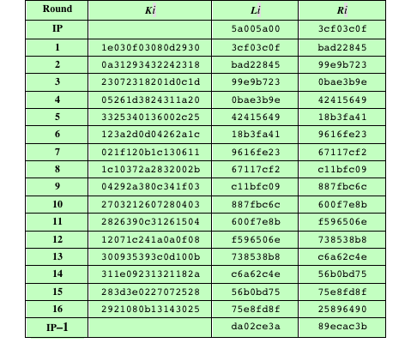
DES
Example
Plaintext:
02468aceeca86420
CEG 260, Meilin Liu
Notes:
Zili Shao

Slide 51
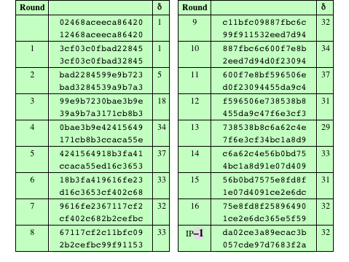
DES
Example
Table 4.3 Avalanche Effect in DES: Change in Plaintext
CEG 260, Meilin Liu
Notes:
Zili Shao

Slide 52
DES
Example
the original key,
0f1571c947d9e859,
And the altered key,
1f1571c947d9e859.
Table 4.3 Avalanche Effect in DES: Change in Key
CEG 260, Meilin Liu
Notes:
Zili Shao

Slide 53
Avalanche Effect
A change of one input or key bit results in changing approximate half output bits
DES exhibits strong avalanche
CEG 260, Meilin Liu
Notes:
Zili Shao

Slide 54
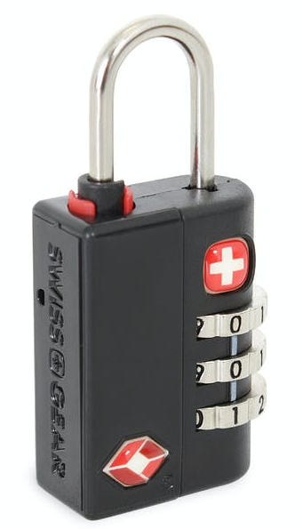
Exhaustive Key Search – Brute Force Attacks
Brute-force Attacks:
How many key combinations for this lock?
How many key combinations for DES with 56 bits of key?
CEG 260, Meilin Liu
Notes:
Zili Shao

Slide 55
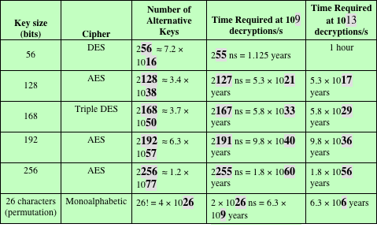
Average Time Required for Exhaustive Key Search
CEG 260, Meilin Liu
Notes:
Zili Shao

Slide 56
Block Cipher Design Principles:
Key Schedule Algorithm
With any Feistel block cipher, the key is used to generate one subkey for each round
In general, we would like to select subkeys to maximize the difficulty of deducing individual subkeys and the difficulty of working back to the main key
It is suggested that, at a minimum, the key schedule should guarantee key/ciphertext Strict Avalanche Criterion and Bit Independence Criterion
© 2020 Pearson Education, Inc., Hoboken, NJ. All rights reserved.
Notes:
With any Feistel block cipher, the key is used to generate one subkey for each
round. In general, we would like to select subkeys to maximize the difficulty of
deducing individual subkeys and the difficulty of working back to the main key. No
general principles for this have yet been promulgated.
Adams suggests [ADAM94] that, at minimum, the key schedule should
guarantee key/ciphertext Strict Avalanche Criterion and Bit Independence
Criterion.

Slide 57
DES Weak Keys
Keys to avoid: C0;D0: 0. . . 0, 1. . . 1, 0101. . . , 1010. . .
Sequential key search: avoid low-numbered keys
CEG 260, Meilin Liu
Notes:
Zili Shao

Slide 58
DES Weak Keys
Keys to avoid: C0;D0: 0. . . 0, 1. . . 1, 0101. . . , 1010. . .
Sequential key search: avoid low-numbered keys
CEG 260, Meilin Liu
Notes:
Zili Shao

Slide 59
Cryptoanalysis of DES
Linear Cryptanalysis
Differential Cryptanalysis
Linear Cryptanalysis
  Given many input/output pairs, can recover key in time less than 2⁵⁶
  Known Plaintext Attacks
Differential Cryptanalysis
  Chosen Plaintext Attacks
  The attacker knows many (plaintext, ciphertext) pairs
CEG 260, Meilin Liu
Notes:
Zili Shao

Slide 60

Linear and differential attacks [BS’89,M’93]
Given many inp/out pairs, can recover key in time less than 2⁵⁶ .
Linear cryptanalysis (overview) : let c = DES(k, m)
Suppose for random k,m :
Pr[ m[i₁]⨁⋯⨁m[i_{r}] ⨁ c[j_{j}]⨁⋯⨁c[j_{v}] = k[l₁]⨁⋯⨁k[l_{u}] ] = ½ + ε
For some ε.
For DES, this exists with ε = 1/2²¹ ≈ 0.0000000477
Notes:
If S-boxes were random, then ε = 1/2¹⁰

Slide 61
Linear attacks
Pr[ m[i₁]⨁⋯⨁m[i_{r}] ⨁ c[j_{j}]⨁⋯⨁c[j_{v}] = k[l₁]⨁⋯⨁k[l_{u}] ] = ½ + ε
Thm: given 1/ε² random (m, c=DES(k, m)) pairs then
k[l₁,…,l_{u}] = MAJ [ m[i₁,…,i_{r}] ⨁ c[j_{j},…,j_{v}] ]
with prob. ≥ 97.7%
⇒ with 1/ε² inp/out pairs can find k[l₁,…,l_{u}] in time ≈1/ε² .

Slide 62
Linear attacks
For DES, ε = 1/2²¹ ⇒
with 2⁴² input/output pairs can find k[l₁,…,l_{u}] in time 2⁴²
Roughly speaking: can find 14 key “bits” this way in time 2⁴²
Brute force remaining 56−14=42 bits in time 2⁴²
Total attack time ≈2⁴³ ( << 2⁵⁶ ) with 2⁴² random input/output pairs

Slide 63
Differential attacks
The main difference from linear attack is that differential attack involves comparing the XOR of two inputs to the XOR of the corresponding outputs.
Differential attack is a chosen-plaintext attack.

Slide 64
Attacks on the Implementation
Side Channel Attacks: Timing attacks, Power attacks, cache attacks
Timing attacks
  One in which information about the key or the plaintext is obtained by observing how long it takes a given implementation to perform decryptions on various ciphertexts
  Exploits the fact that an encryption or decryption algorithm often takes slightly different amounts of time on different inputs
  So far it appears unlikely that this technique will ever be successful against DES or more powerful symmetric ciphers such as triple DES and AES
Power attacks: by measuring the power consumption when performing the decryptions on various ciphertexts, to derive the key or the plaintext
Cache attacks: by observing the cache misses when performing the decryptions on various ciphertexts, to derive the key or the plaintext
CEG 260, Meilin Liu
Notes:
Zili Shao

